Slide 1
Project Overview

Slide 2
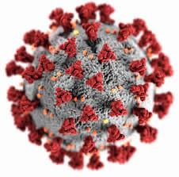
Covid-19 Prediction/ Reporting

Slide 3

Data Lake
Data Lake to be built with the following data to aid Data Scientists to predict the spread of the virus/ mortality
Confirmed cases
Mortality
Hospitalization/ ICU Cases Testing Numbers
Country’s population by age group

Slide 4
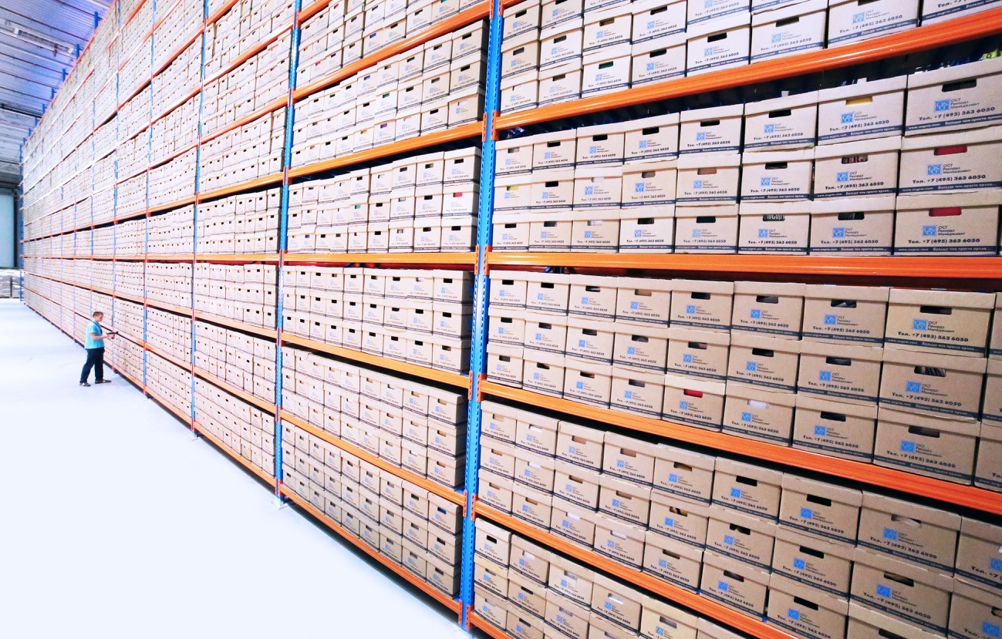
Data Warehouse to be built with the following data to aid Reporting on Trends
Data Warehouse
Confirmed cases
Mortality
Hospitalization/ ICU Cases Testing Numbers

Slide 5













Solution Architecture
Transformation
ECDC COVD-19
data (HTTP Connector)
Ingest
Transform/ Analyze
Publish
Azure Data Lake Storage Gen2
Azure SQL Database
Population Data (Azure Blob Storage)
Azure Data Lake Storage Gen2
ML Models

Slide 6
Population By Age
Ingest “population by age” for all EU countries to data lake to support ML models to predict mortality rates.

Slide 7



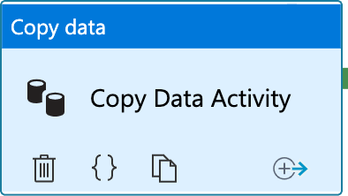

Copy Activity
Source
Sink
Azure Blob Storage
Azure Data Lake
Source File (Zipped TSV)
Target File (TSV)
Copy Activity

Slide 8

Copy Activity From Azure Blob Storage

Slide 9









Copy Activity
Pipeline
5
Source
Sink
1
ls_ablob_covidreportingsa
2
ds_population_raw_gz
1
3
Linked Service
Azure Blob Storage
Linked Service
Azure Data Lake
3
ls_adls_covidreportingdl
4
ds_population_raw_tsv
Source File (Zipped TSV)
2
4
Target File (TSV)
Source Data Set
Copy Activity
6
Sink Data Set
5
pl_ingest_population_data
Storage Account: covidreportingdl Container: raw
File: population/population_by_age.tsv
6
Copy Population Data
Storage Account: covidreportingsa Container: population
File: population_by_age.tsv.gz

Slide 10
Scenario 1
Execute Copy Activity when the file becomes available

Slide 11
Scenario 2
Execute Copy Activity only if file contents are as expected

Slide 12
Scenario 3
Delete the source file on successful copy

Slide 13
Data Ingestion Requirement
Covid 19 – new cases and deaths by country
Covid 19 – Hospital admissions and ICU cases
Covid 19 – Testing Numbers
Covid 19 – Country Response to Covid 19
URL- Download COVID-19 data (europa.eu)

Slide 14
Data Ingestion
Case & Deaths Data
URL - https://www.ecdc.europa.eu/en/publications-data/data-national-14-day-notification-rate-covid-19

Slide 15




Copy Activity – Case & Deaths Data
Pipeline
5
ls_http_opendata_ecdc_eu ropa_eu
Source
Sink
1
2
ds_cases_deaths_raw_csv
_http
1
3
Linked Service
HTTP
Linked Service
Azure Data Lake
3
ls_adls_covidreportingdl
4
ds_cases_deaths_raw_csv
_dl
Source File (CSV)
2
4
Target File (CSV)
Source Data Set
Copy Activity
6
Sink Data Set
5
pl_ingest_cases_deaths_d ata
6
Copy Cases And Deaths Data
URL:
https://opendata.ecdc.europa.eu/covid19/nationalcasedeath/csv
Storage Account: covidreportingdl Container: raw
File: ecdc/cases_deaths.csv

Slide 16


Copy Activity – Hospital Admission Data
Pipeline
5
ls_http_opendata_ecdc_eu ropa_eu
Source
Sink
1
2
ds_hospital_admissions_ra w_csv_http
1
3
Linked Service
HTTP
Linked Service
Azure Data Lake
3
ls_adls_covidreportingdl
4
ds_hospital_admissions_ra w_csv_dl
Source File (CSV)
2
4
Target File (CSV)
Source Data Set
Copy Activity
6
Sink Data Set
5
pl_ingest_hospital_admissi ons_data
6
Copy Hospital Admissions Data
URL:
https://opendata.ecdc.europa.eu/covid19/hospitalicuadmission rates/csv/data.csv
Storage Account: covidreportingdl Container: raw
File: ecdc/hospital_admissions.csv

